Slide 1
Insurance and what effects it
Gabriela Mallett
DSC530
Professor Cary Jim
June 3, 2023

Slide 2

What to Expect

Slide 3

Introduction
In the United States insurance can be a touchy subject; some people may get them through their jobs others may not and will have to search else where or go without insurance. The dataset I am using will show some of the things that can insurance rates and charges.

Slide 4
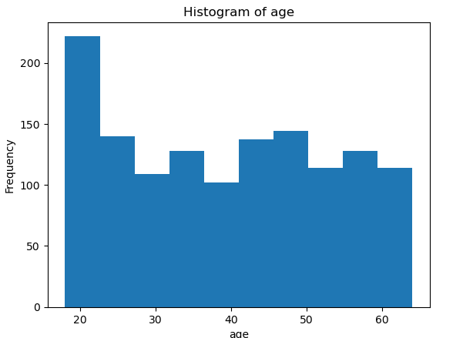
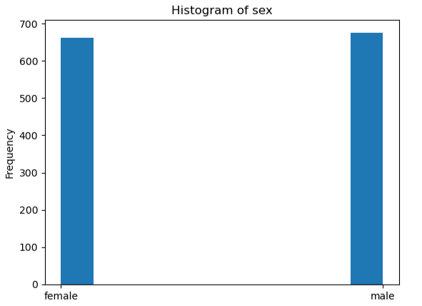
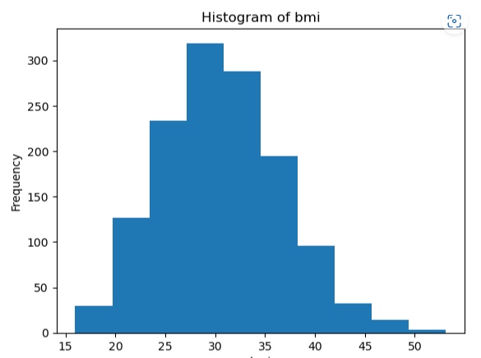
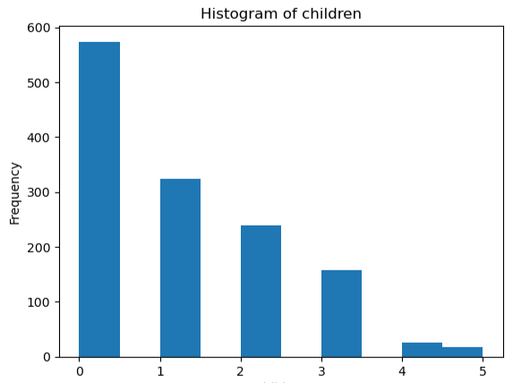
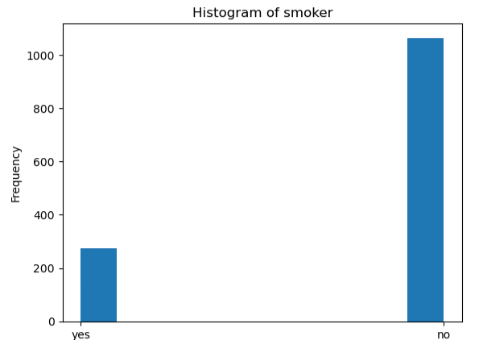
Age, Sex, BMI, Children, and Smoking

Slide 5

The variables in the previous slide were important to deciding what things affects insurance rates or not.
After performing a few tests, the most significant variables to affect rates were age and BMI, with people who were older or had higher BMIs paying more on average.

Slide 6
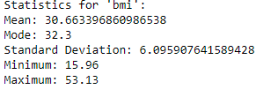

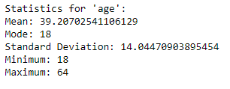
Statistics
In the variables shown, we see the mean and mode, among a variety of others. For BMI the mean is 30, while the most commonly appearing number is 32. This puts quite a bit of people in the overweight category.
For age, the most commonly appearing age is 18, while the mean is actually 39, which means there is probably many older respondents as well.
And there were overall, more male respondents.

Slide 7
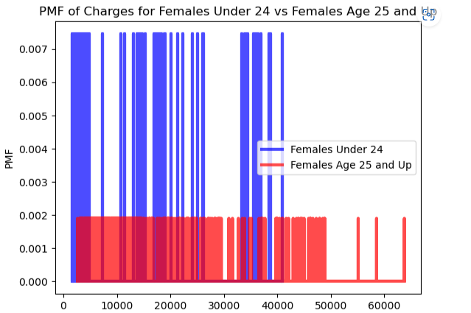
Females 24 and under and 25 and up
The PMF to the right, shows females who are under 25, and those who are over 25, based on the PMF older females are charged more for insurance.

Slide 8
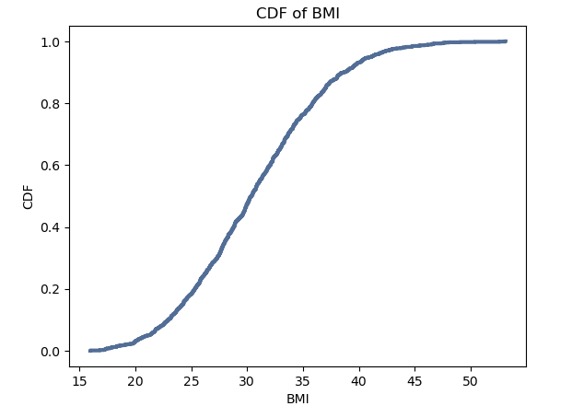
BMI CDF
Pictured to the left is the CDF of BMI, while this is not a step, it does show a steep up turn at about 30 bmi, before settling at around 40.

Slide 9
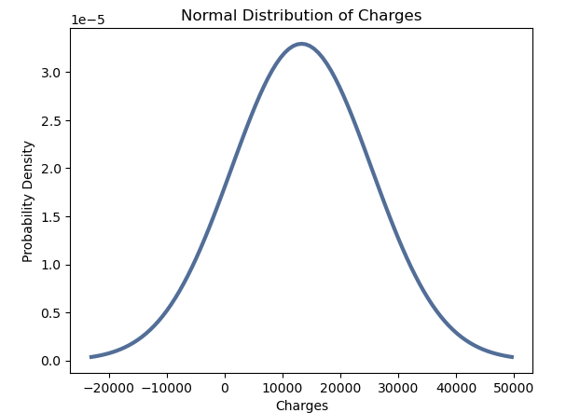
Distribution of Charges
The graph shows a high point at around 15000 charges, before dropping again, showing that the most people are paying around that much.

Slide 10
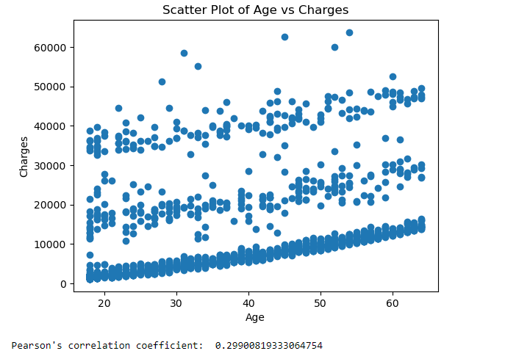
Pearson correlation
The scatter plot shows a weak, but positive correlation between age and charges.

Slide 11

Hypothesis Testing
Using the age variable against the charges variable, it showed a p-value of: 0.0 which concluded a null hypothesis, which was not nearly as strong as the pearson correlation, which was already a weak positive.

Slide 12
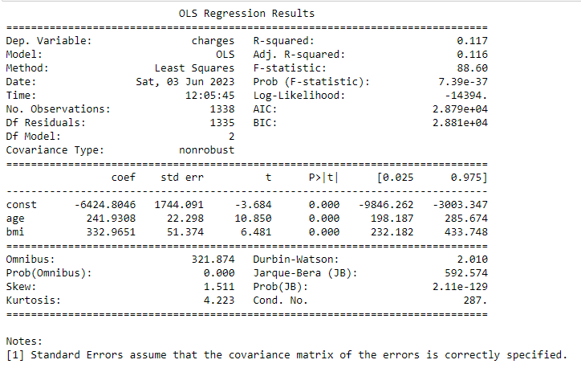
The r-Squared value shows that BMI and Age has approximately 11.7% of explaining a change in variables, while the adjusted r-squared shows 11.6%. Again, showing a weak positive.
Regression on Variables

